Slide 1

TSW_IIT_Hackathon_#1
Team 9: - ML Junkies
Aayush, Devanshu, Dilip and Prasanna

Slide 2
What?
Problem Statement: -
Predict if a customer is going to accept a coupon for a particular venue, considering demographic and contextual attributes obtained from historical customer data.
Solution: -
Considering given set of data and attributes build a model which will be able to process key attributes from given historical data and predict which set of customer are likely to accept and use the coupon leading to a higher positive conversion ratio and reducing the overall bad conversion ratio to optimize the cost and benefits.

Slide 3
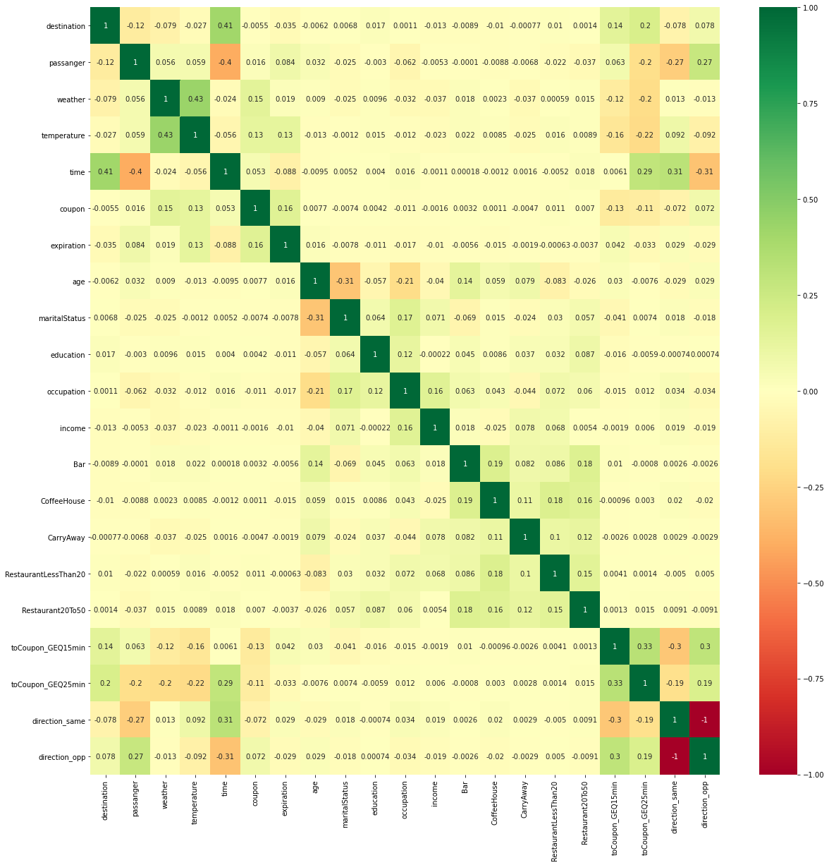
How?
Based on the combination of ExtraTreesClassifier, Chi() test and mutual info test above best fit attributes were identified which were used to optimize the model.

Slide 4
How? Insights.
When feature “coupon” has values like “Carry Out and take away” or “restaurantLessThan20” has 73% chances of coupon being used.
When feature “coupon” has value “restaurantLessThan20” 75% chance of coupon being used.
When feature “education” has values like “some high school students” coupon are more likely to be used around 78% of time but distribution is less for this category.
When feature “occupation” has values like “healthcare practitioner & technical” and “healthcare support” are most likely to use the coupons around 69%.

Slide 5
Why?
Prediction (12,89,500) | Predicted: No | Predicted: Yes | Count
Actual: No | (True Negative) -500 * 718 = -3,59,000 2000 *718 = 14,36,000 | (False Positive) -2500 * 377 = -9,42,500 | 1,34,500
Actual: Yes | (False Negative) -2500 * 252 = -6,30,000 | (True Positive) -500 * 1190 = -5,95,000 2000*1190 = 23,80,000 | 11,55,000
Count |  |  | 12,89,500
Attribute | Score
Accuracy | 76%
Recall | 76%
F1 Score | 76%
Value | Cost per Customer | Count | Total Cost
TN | 500 | 718 | -3,59,000 14,36,000
FN | -2500 | 252 | -6,30,000
FP | -500 | 377 | -9,42,500
TP | 500 | 1190 | -5,95,000 23,80,000
Total |  | 2537 | 12,89,500
Cost of ML per customer for period of implementation and usage is 500 rs/person.
Cost of Coupon, Logistics for Coupon and Loss in revenue if conversion does not happen is 2000 rs. We assume the same cost as +ve income when predictions are right/ but ML costs is still incurred and subtracted.

Slide 6
Why? Insights.
As per the previous cost analysis against the Confusion Matrix score of the Model it is evidently clear that business is going to gain with the change in approach.
Other factors to consider implementing model in production are as below
Cost of the ML model development and deployment is one time cost.
Their will be cost of Maintenance, but it would be quite on lower side compared to gains in business over the time.

Slide 7
Appendix
Model Used :- Random Forest based Stacking model which includes a Bagging and Gradient Boosting Methods.
Accuracy score of 76.23% was obtained with important features and stacking technique.
While F1 and Recall were also at higher side 76%.

Slide 8
Thank You

